Slide 1
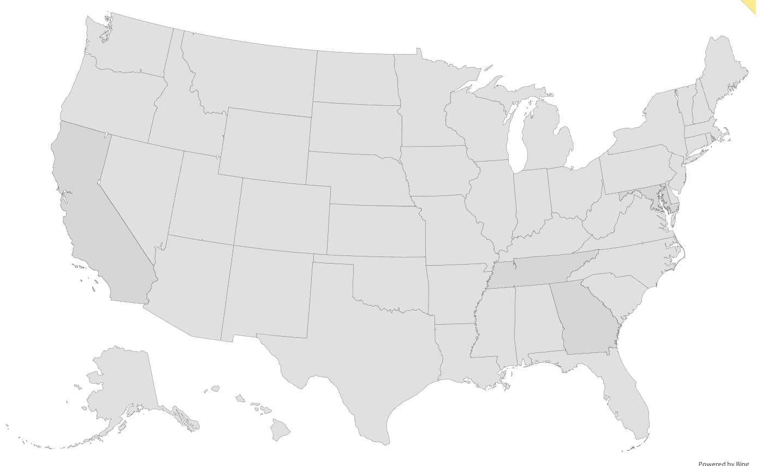
Team Coast-2-Coast
Zaire
Christina
Paulina
Alejandra
Sandra

Slide 2
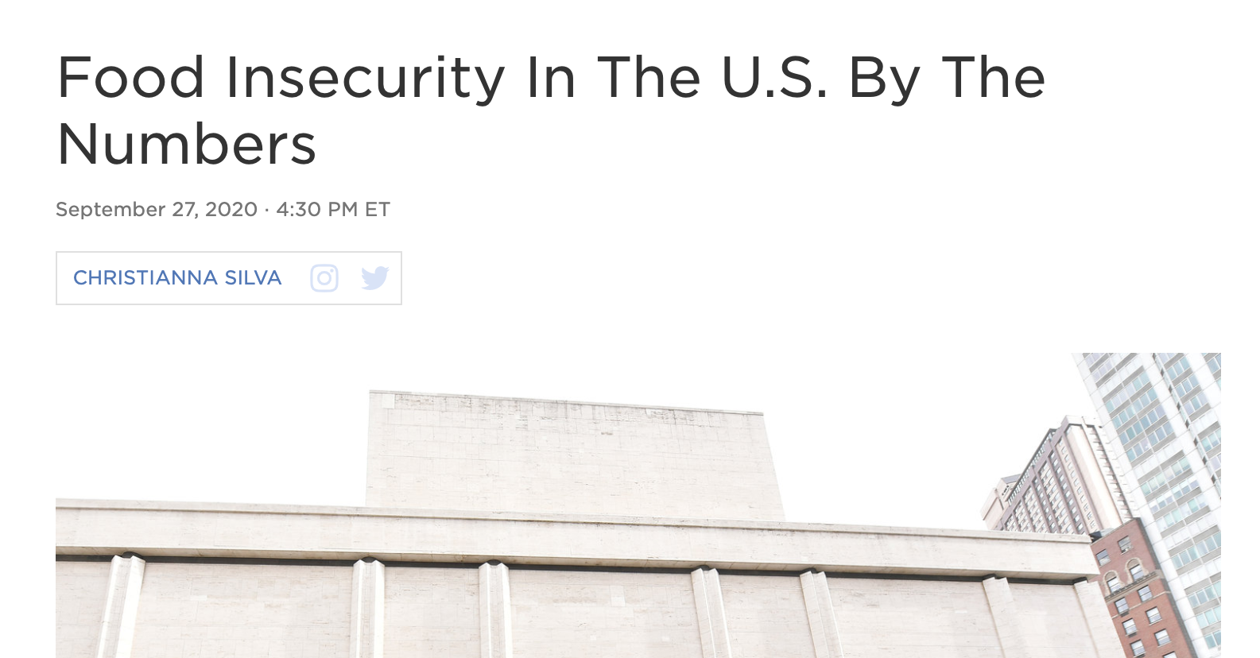
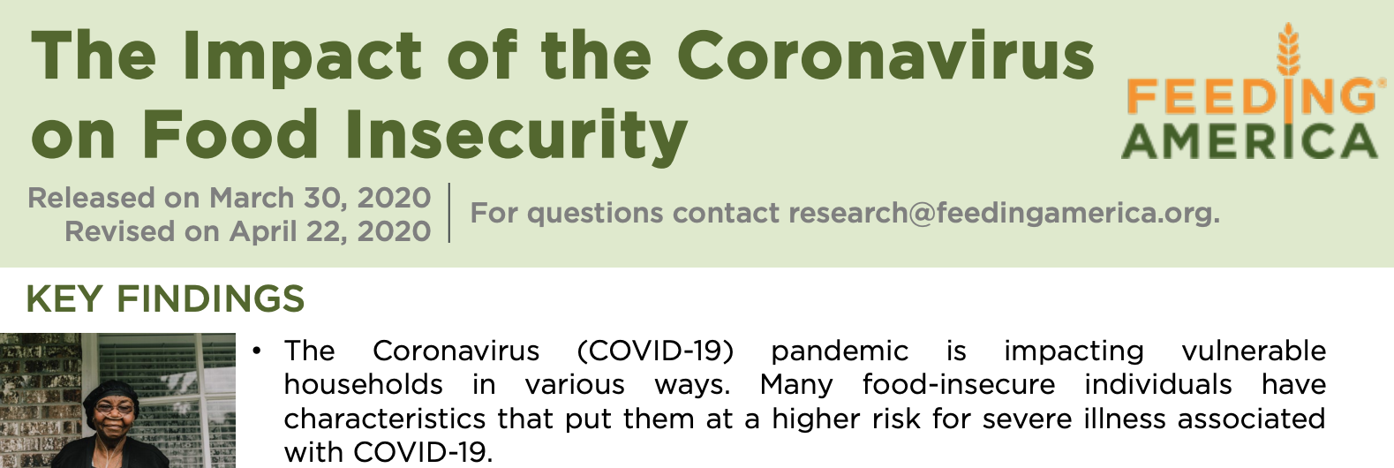
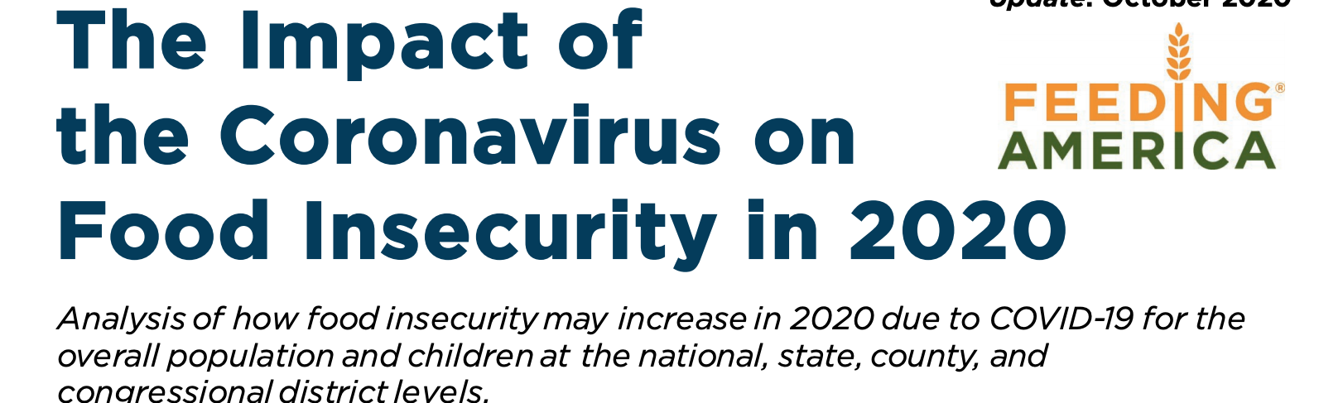
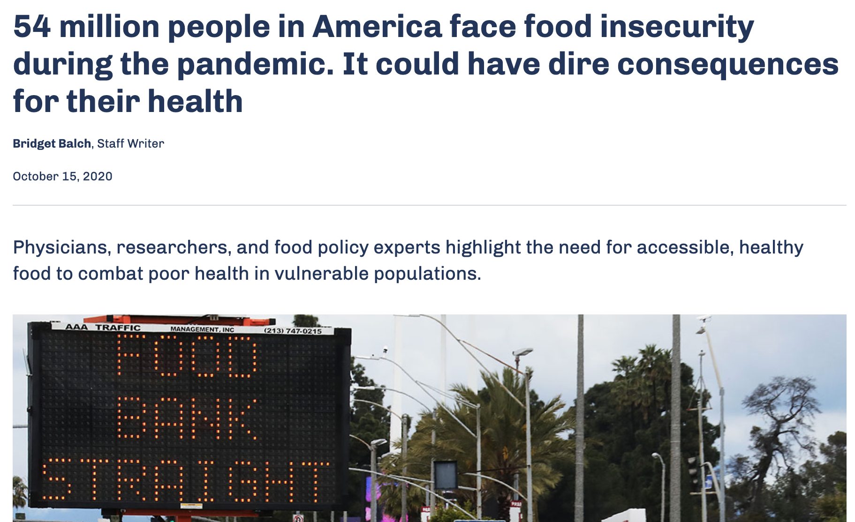
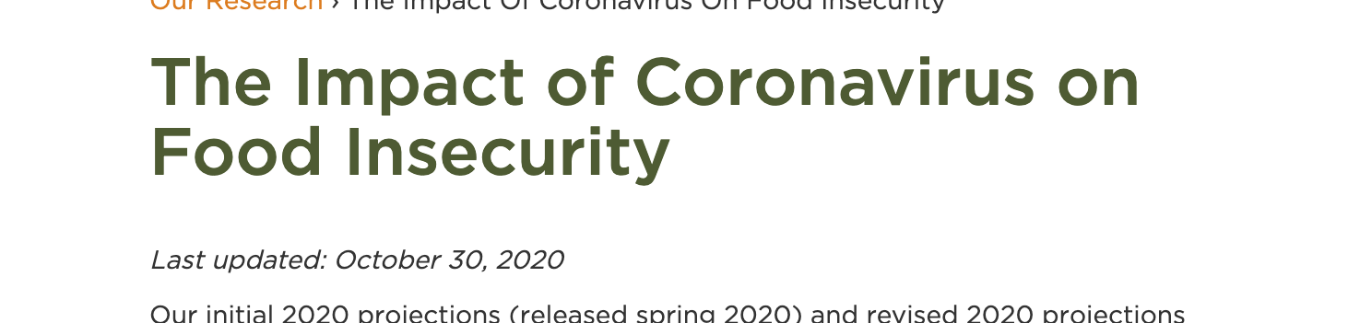
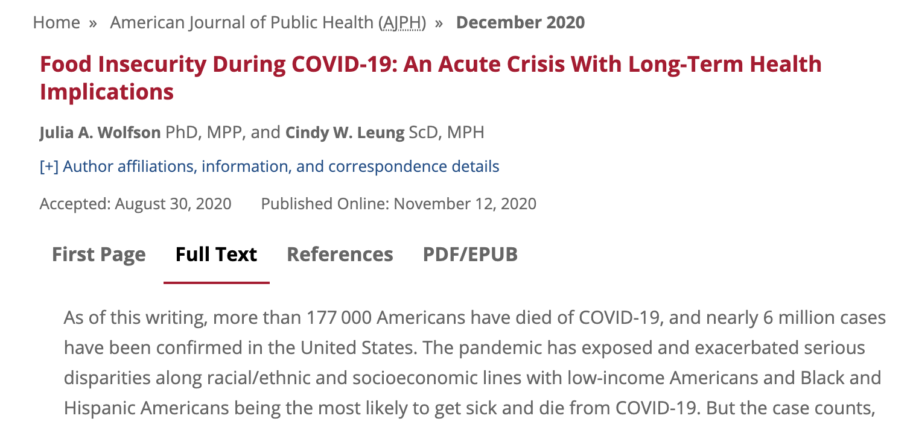
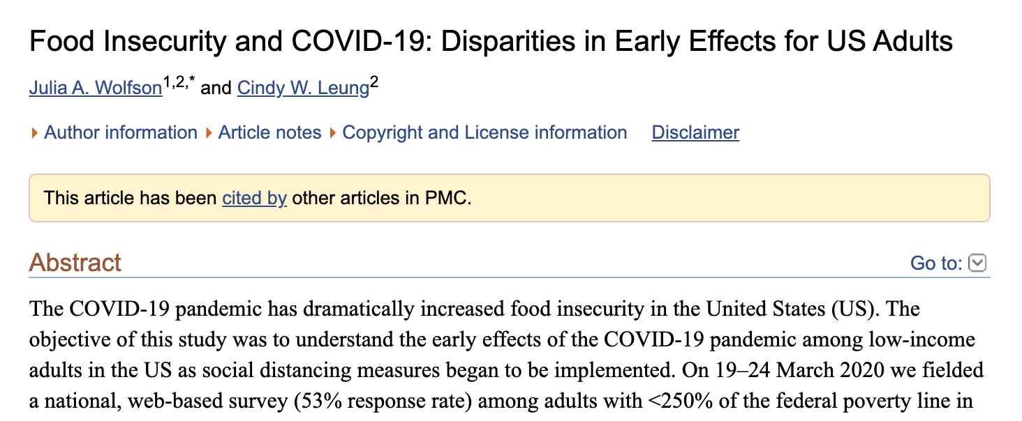
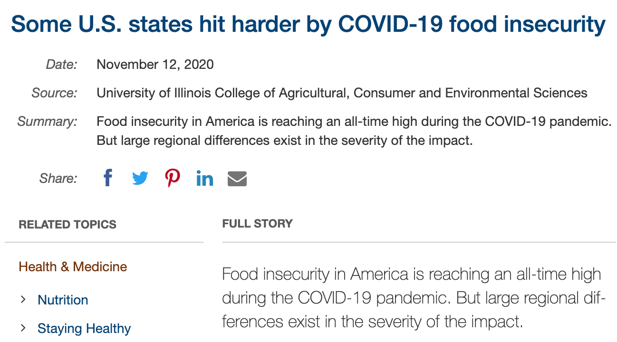
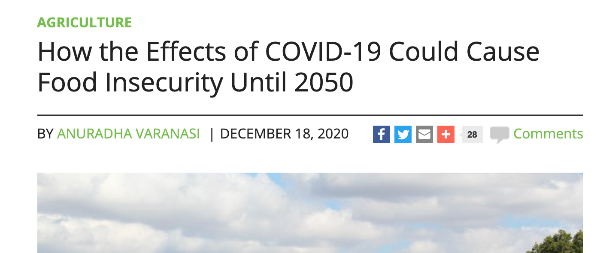
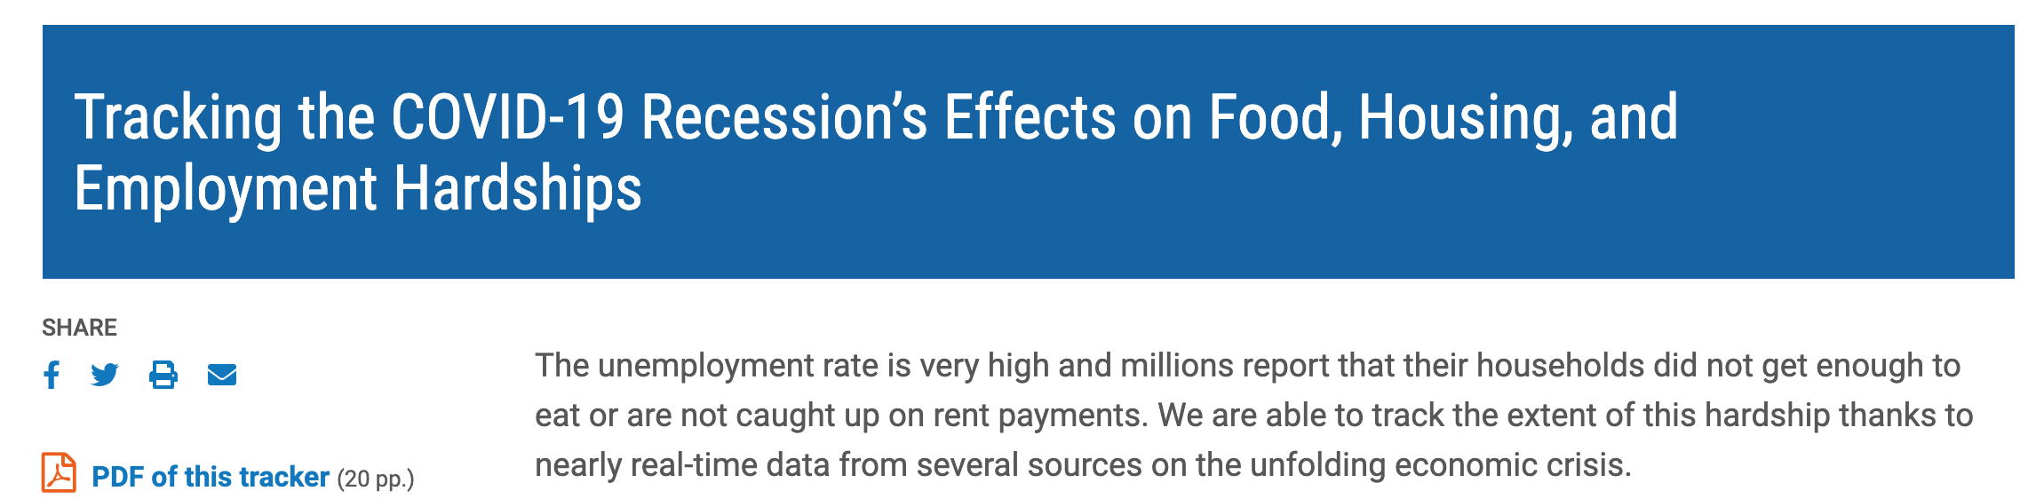
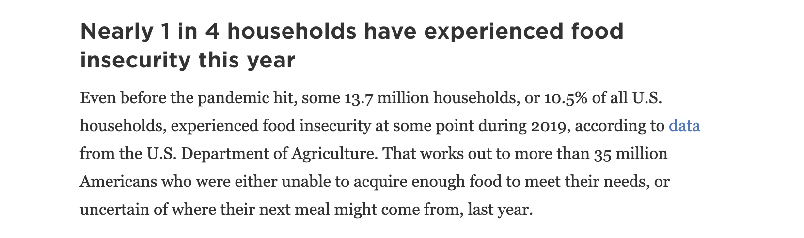
Food Insecurity
Team 39 a.k.a. C2C

Slide 3
Food Insecurity
Team 39 a.k.a. C2C

Slide 4
U.S. 2019 Food Insecurity Rate
10.5 %

Slide 5
34 %
As high as
8.6 %
As low as

Slide 6
Food Insecurity
Team 39 a.k.a. C2C

Slide 7
On the U.S. County Level, is Distance to Food Banks a Predictor for Food Insecurity?

Slide 8

Empirical Challenge
Our Process & Methodology

Slide 9
Initial Questions ….
What is the county’s Food Insecurity Rate? (Pre-covid and Covid Data)
Does the county have a Food Bank?
If no, how far is the nearest Food Bank?
What demographics of each county, would we focus on?

Slide 10
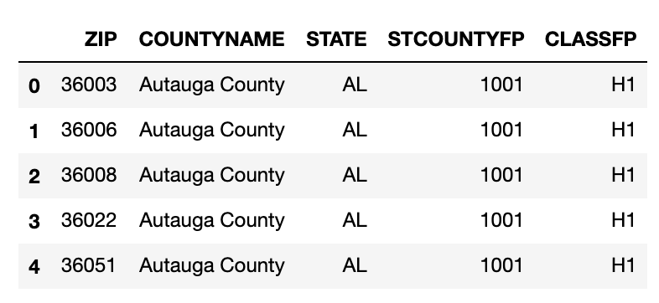
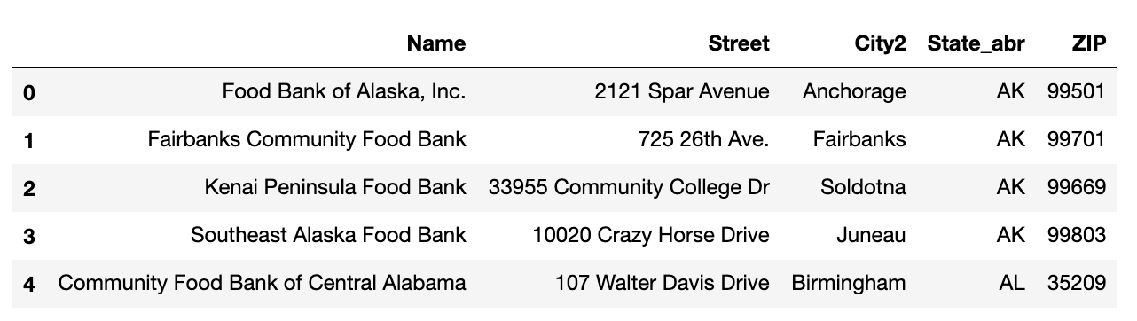
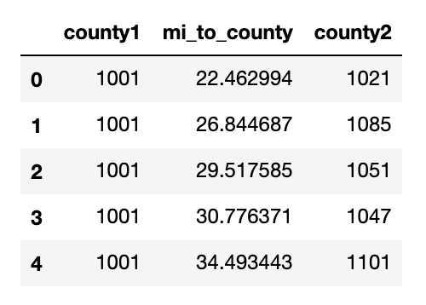
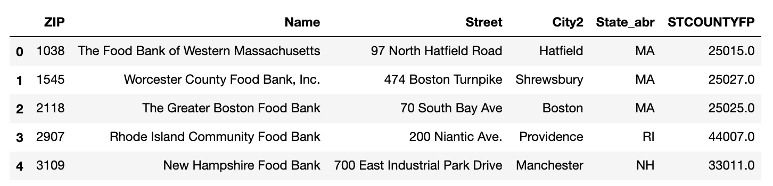
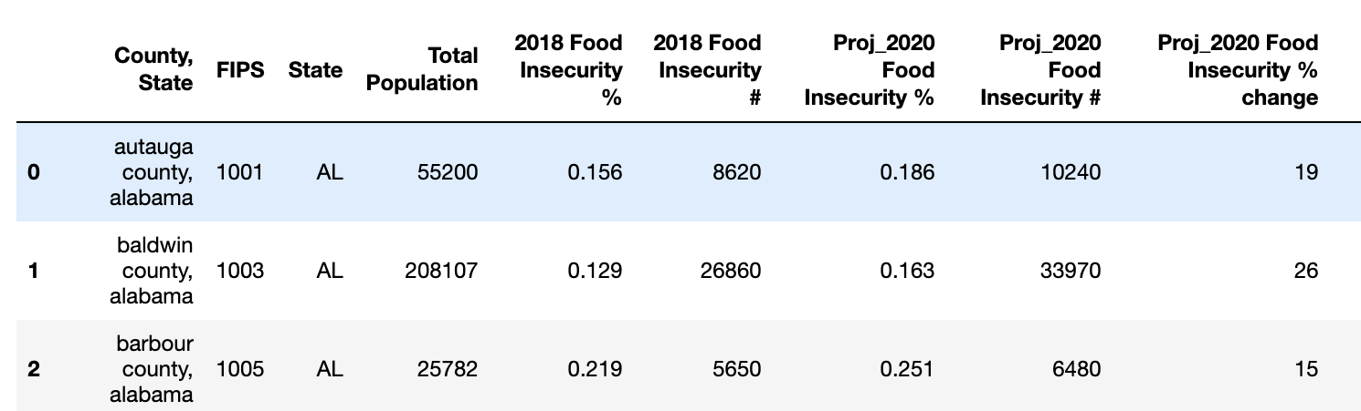
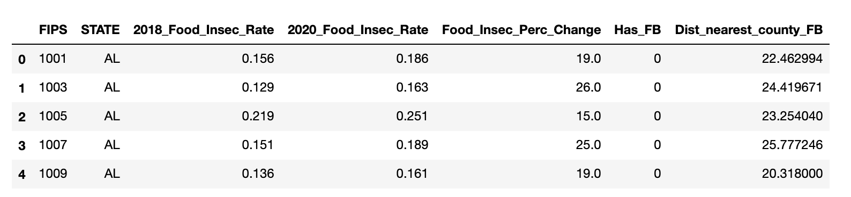
FIPS Data Frame
Food Bank Location Data Frame
Data.world
FeedingAmerica.org
Distance Data Frame
Food Insecurity Data Frame
FeedingAmerica.org
National Bureau of Economic Research
Final Data Frame
U.S. Department of Agriculture

Slide 11
Final Variables
Food Insecurity Percent Change (2018-2020)
Has Food Bank? Yes-1 / No-0
Distance to nearest Food Bank (within 100 miles)
Demographics:
Poverty Rate
Unemployment Rate
Education Level

Slide 12
Our Analysis
Our Process & Methodology

Slide 13
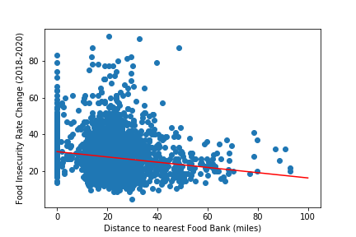


Linear Regression Model
$$y=B0+B1∗x$$
$$B0=30.730$$
$$B1=−0.142$$
There is not a strong correlation…

Slide 14
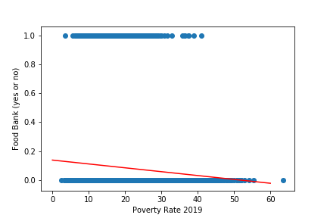
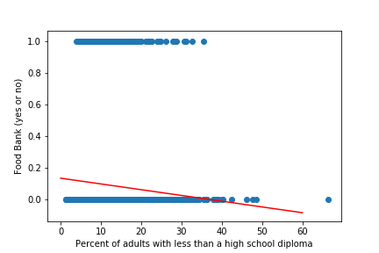
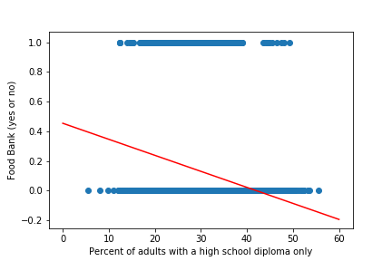
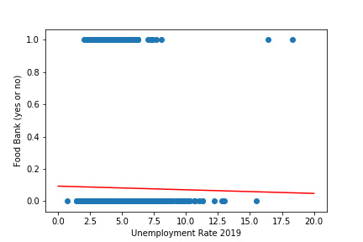
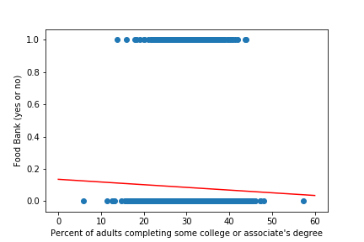
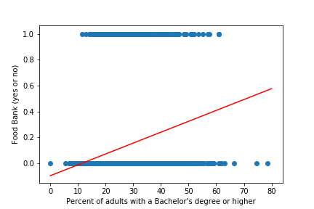
Linear Probability Models

Slide 15
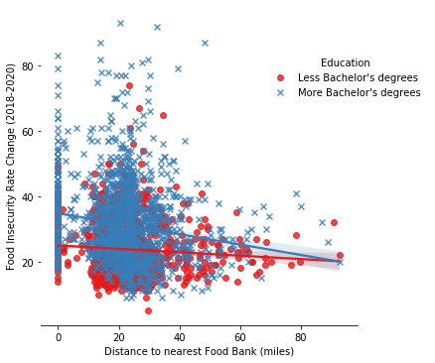
Linear Regression Model with Interaction Variable
Food banks have less of an impact in counties with less college graduates
Distance to the nearest food bank in counties is not a significant predictor of food insecurity

Slide 16
On the U.S. County Level, is Distance to Food Banks a Predictor for Food Insecurity?

Slide 17
NO

Slide 18
Our Findings
Our graphs suggested that the further away the county was from the nearest food bank the lower the food insecurity was.
They also indicated that there was a greater chance of finding a food bank in counties with more college educated adults.

Slide 19
Takeaways
Food insecurity is an increasingly relevant issue that doesn’t have as much available research to help understand and combat it.
We were able to gather and synthesize dataframes to give us a better insight into food banks and how they impact food inequality.
We are happy to have added research to food insecurity and we are hopeful that more research will be done to reduce hunger and promote nutrition within our communities!

Slide 20

Thank You

Slide 21
Team Coast-2-Coast
Zaire
Christina
Paulina
Alejandra
Sandra

Slide 22

Our Learnings
Analysis of the Data

Slide 23
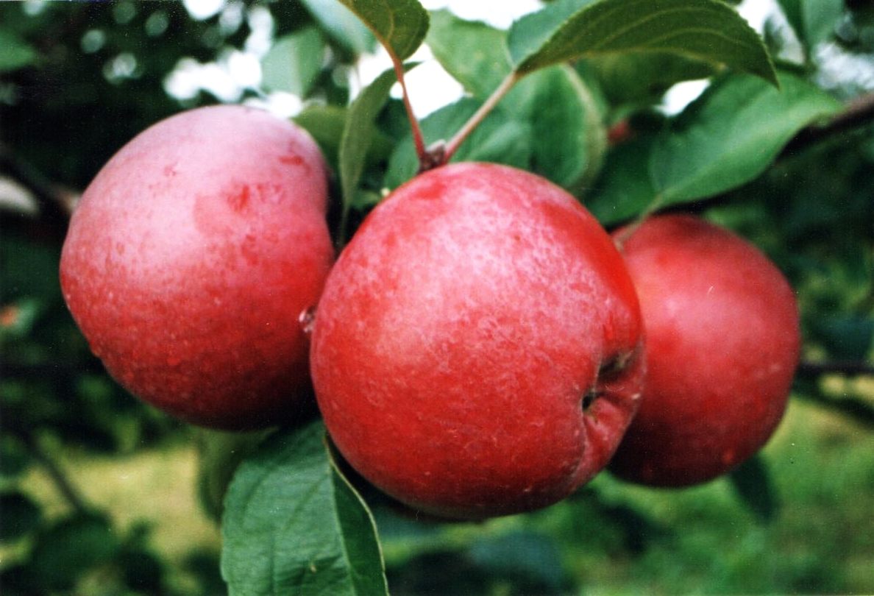
On the U.S. County Level, is Distance to Food Banks a Predictor for Food Insecurity?

Slide 24
Machine Learning
Our Process & Methodology

Slide 25
Recommendation

Slide 26
FIPS Data Frame
Food Bank Location Data Frame
Data.world
FeedingAmerica.org
Distance Data Frame
Food Insecurity Data Frame
FeedingAmerica.org
National Bureau of Economic Research
Final Data Frame

